Slide 1
UNIT-III Part - I
Thin film solar cell technologies:
Generic advantages of twin film technologies - materials for thin film technologies – thin film de position techniques
– Common features thin film technologies.

Slide 2
A thin-film solar cell is a second generation solar cell that is made by depositing one or more thin layers, or thin film (TF) of photovoltaic material on
a substrate, commercially
such as glass, plastic or metal. Thin-film solar cells are used in several technologies, including cadmium telluride
(CdTe), copper indium gallium diselenide (CIGS), and amorphous thin-film silicon (a- Si, TF-Si).
Film thickness varies from a few nanometers (nm) to tens of micrometers (µm), much thinner than thin-film's rival technology, the conventional, first- generation crystalline silicon solar cell (c-Si), that uses wafers of up to 200 µm thick. This allows thin film cells to be flexible, and lower in weight. It is used in building integrated photovoltaics and as semi-transparent, photovoltaic glazing material that can be laminated onto windows. Other commercial applications use rigid thin film solar panels (interleaved between two panes of glass) in some of the world's largest photovoltaic power stations.

Slide 3
3.1 Generic advantages of thin film technologies
1. Requires less Material.
This is the reason thin film was attractive to begin with. Thin
film materials have a property, called bandgap, which is superior to silicon. Funny as it sounds, silicon just doesn’t like to absorb light. First of all, it only wants to absorb low wavelength light (red and IR), rather than most of the light that comes from the sun. It has the wrong bandgap (which wavelength is absorbed), and it doesn’t even absorb that very well. It takes over 100 microns of material to absorb the light, where thin film takes only 1 micron. Thin film absorbs the right wavelengths, and does it with 100x less material. In an industry where materials cost is important, thinner is much better.

Slide 4
2. Glass substrates can be used.
Thin film uses a less expensive and easier to work with substrate (what the solar cell is built on). While silicon uses silicon (duh), most thin film uses glass. Silicon is more than 10 times more expensive, ($36/m² vs. $3.60/m²). To repeat: materials costs are very important.
3. High power for less investment.
A single thin film production line can achieve 300 MW output per year vs. the 25 MW standard for c-Si. This scaling advantage is huge when it comes to reducing those non-materials costs such as labor, overhead, and depreciation.

Slide 5
4. Capital Expenditure is less in installing a manufacturing unit.
High-capacity glass processing tools, beside the impact on cost, also have lower capital intensity. Solar is considered a capital-intensive business, measured by how much it costs to build a factory in $/watt. The “dollar” is the factory capital cost and the “watt” is the yearly output. Silicon factories are very capital intensive, with polysilicon, wafer, solar cell, and panel factories adding up to over $1.40/watt. Thin film, on the other hand, ranges from $0.50 to $1.00/watt, and the 300-MW factory mentioned above would only be $.33/watt, a 4x advantage in capital intensity. The graph below shows the CapEx difference if added capacity were either all c-Si or all thin film. To put the impact in perspective, if solar gets to just a 14 percent penetration of the energy industry, the CapEx difference would amount to over $5 trillion. That is not a typo. That is trillion with a “T.”
Capital intensity is not talked about much yet, but it may become the deciding factor in the growth of the solar industry. Low capital intensity is a huge advantage. Thin film can affordably scale to meet our energy needs.

Slide 6
5. Higher Efficiency.
Thin film is no longer at an efficiency disadvantage vis-a-vis silicon. Throughout solar history c-Si has had better efficiency, but in late 2013, thin film (CIGS) beat multi-crystalline silicon in laboratory efficiency. This lab result hasn’t transferred to the production floor yet, but this should happen in just a few years. When thin film beats c-Si on performance, the inherent cost advantages will be magnified, and thin film will start its major comeback.
6. Lower Manufacturing costs.
Combine these 100X, 10X and 4X cost advantages with high efficiency and you get the lowest manufacturing cost. As recently published (link), Siva Power outlined its thin film cost roadmap, showing CIGS getting to $0.28/watt within four years. That is an unheard-of number for c-Si technology.

Slide 7
3.2 materials for thin film technologies
Thin-film technologies reduce the amount of active material in a cell. Most sandwich active material between
two panes of glass. Since silicon solar panels only use one
pane of glass, thin film panels are approximately twice as heavy as crystalline silicon panels, although they have a smaller ecological impact (determined from life cycle
analysis). The majority of film panels have 2-3 percentage points lower conversion efficiencies than crystalline silicon. Cadmium telluride (CdTe), copper indium gallium selenide (CIGS) and amorphous silicon (a-Si) are three thin-film technologies often used for outdoor applications.

Slide 8
3.2.1 Cadmium telluride
Cadmium telluride (CdTe) is the predominant thin film technology. With about 5 percent of worldwide PV production, it accounts for more than half of the thin film market. The cell's lab efficiency has also increased significantly in recent years and is on a par with CIGS thin film and close to the efficiency of multi-crystalline silicon as of 2013. Also, CdTe has the lowest Energy payback time of all mass-produced PV technologies, and can be as short as eight months in favorable locations. A prominent manufacturer is the US- company First Solar based in Tempe, Arizona, that produces CdTe-panels with an efficiency of about 14 percent at a reported cost of $0.59 per watt.
Although the toxicity of cadmium may not be that much of an issue and environmental concerns completely resolved with the recycling of CdTe modules at the end of their life time, there are still uncertainties and the public opinion is skeptical towards this technology. The usage of rare materials may also become a limiting factor to the industrial scalability of CdTe thin film technology. The rarity of tellurium—of which telluride is the anionic form—is comparable to that of platinum in the earth's crust and contributes significantly to the module's cost.

Slide 9
3.2.2 Copper Indium Gallium Selenide
A copper indium gallium selenide solar cell or CIGS cell uses an absorber made of copper, indium, gallium, selenide (CIGS), while gallium-free variants of the semiconductor material are abbreviated CIS. It is one of three mainstream thin-film technologies, the other two being cadmium telluride and amorphous silicon, with a lab-efficiency above 20 percent and a share of 2 percent in the overall PV market in 2013. A prominent manufacturer of cylindrical CIGS-panels was the now-bankrupt company Solyndra in Fremont, California. Traditional methods of fabrication involve vacuum processes including co- evaporation and sputtering. In 2008, IBM and Tokyo Ohka Kogyo Co., Ltd. (TOK) announced they had developed a new, non-vacuum, solution-based manufacturing process for CIGS cells and are aiming for efficiencies of 15% and beyond.

Slide 10
3.2.3 Silicon
Three major silicon-based module designs dominate:
amorphous silicon cells
amorphous / microcrystalline tandem (micromorph)
thin-film polycrystalline silicon on glass.
cells

Slide 11
Amorphous silicon
Amorphous silicon (a-Si) is a non-crystalline, allotropic form of silicon and the most well-developed thin film technology to-date. Thin-film silicon is an alternative to conventional wafer (or bulk) crystalline silicon. While chalcogenide-based CdTe and CIS thin films cells have been developed in the lab with great success, there is still industry interest in silicon-based thin film cells. Silicon-based devices exhibit fewer problems than their CdTe and CIS counterparts such as toxicity and humidity issues with CdTe cells and low manufacturing yields of CIS due to material complexity. Additionally, due to political resistance to the use non-"green" materials in solar energy production, there is no stigma in the use of standard silicon.
This type of thin-film cell is mostly fabricated by a technique called plasma-enhanced chemical vapor deposition. It uses a gaseous

Slide 12
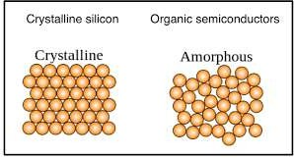
mixture of silane (SiH4) and hydrogen to deposit a very thin layer of only 1 micrometre (µm) of silicon on a substrate, such as glass, plastic or metal, that has already been coated with a layer of transparent conducting oxide. Other methods used to deposit amorphous silicon on a substrate include sputtering and hot wire chemical vapor deposition techniques.

Slide 13
Tandem-cell using a-Si/μc-Si
A layer of amorphous silicon can be combined with layers of other allotropic forms of silicon to produce a multi-junction solar cell. When only two layers (two p-n junctions) are combined, it is called a tandem-cell. By stacking these layers on top of one other, a broader range of the light spectra is absorbed, improving the cell's overall efficiency.
In micromorphous silicon, a layer of microcrystalline silicon (μc-Si) is combined with amorphous silicon, creating a tandem cell. The top a-Si layer absorbs the visible light, leaving the infrared part to the bottom μc-Si layer. The micromorph stacked-cell concept was pioneered and patented at the Institute of Microtechnology (IMT) of the Neuchâtel
University in Switzerland,^{[22]} and was licensed to TEL Solar. A new world record PV module based on the micromorph concept with 12.24% module efficiency was independently certified in July 2014.
Because all layers are made of silicon, they can be manufactured using PECVD.
The band gap of a-Si is 1.7 eV and that of c-Si is 1.1 eV. The c-Si layer can absorb red and infrared light. The best efficiency can be achieved at transition between a-Si and c-Si. As nanocrystalline silicon (nc-Si) has about the same bandgap as c-Si, nc-Si can replace
c-Si.

Slide 14
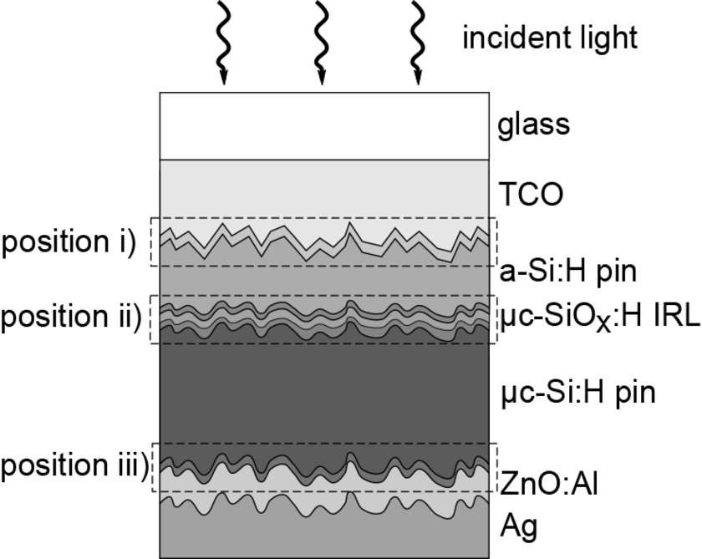

Slide 15
Tandem-cell using a-Si/pc-Si
Amorphous silicon can
also be combined
a tandem-cell.
with protocrystalline silicon (pc-Si) into
Protocrystalline silicon with a low volume fraction of nanocrystalline silicon is optimal for high open-circuit voltage. These types of silicon present dangling and twisted bonds, which results in deep defects (energy levels in the bandgap) as well as deformation of the valence and conduction bands (band tails).

Slide 16
Polycrystalline silicon on glass
A new attempt to fuse the advantages of bulk silicon with those of thin-film devices is thin film polycrystalline silicon on glass. These modules are produced by depositing an antireflection coating and doped silicon onto textured glass substrates using plasma-enhanced chemical vapor deposition (PECVD). The texture in the glass enhances the efficiency of the cell by approximately 3% by reducing the amount of incident light reflecting from the solar cell and trapping light inside the solar cell. The silicon film is crystallized by an annealing step, temperatures of 400–600 Celsius, resulting in polycrystalline silicon.
These new devices show energy conversion efficiencies of 8% and high manufacturing yields of >90%. Crystalline silicon on glass (CSG), where the polycrystalline silicon is 1–2 micrometres, is noted for its stability and durability; the use of thin film techniques also contributes to a cost savings over
bulk photovoltaics. These modules do not require the presence of a transparent conducting oxide layer. This simplifies the production process twofold; not

Slide 17
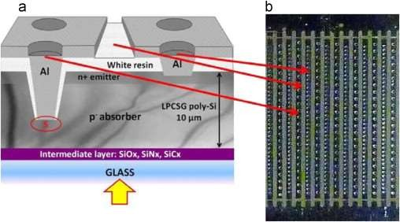
only can this step be skipped, but the absence of this layer makes the process of constructing a contact scheme much simpler. Both of these simplifications further reduce the cost of production. Despite the numerous advantages over alternative design, production cost estimations on a per unit area basis show that these devices are comparable in cost to single-junction amorphous thin film cells.

Slide 18
Gallium arsenide The semiconductor material gallium arsenide (GaAs) is also used for single- crystalline thin film solar cells. Although GaAs cells are very expensive, they hold the world record for the highest-efficiency, single-junction solar cell at 28.8%.^{[26]} GaAs is more commonly used in multi-junction solar cells for solar panels on spacecrafts, as the larger power to weight ratio lowers the launch costs in space-based solar power (InGaP/(In)GaAs/Ge cells). They are also used in concentrator photovoltaics, an emerging technology best suited for locations that receive much sunlight, using lenses to focus sunlight on a much smaller, thus less expensive GaAs concentrator solar cell.

Slide 19
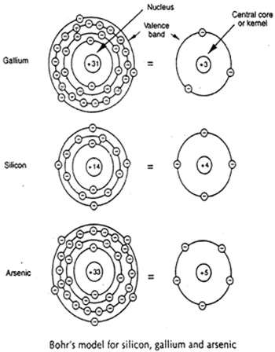

Slide 20
3.3 thin film de position techniques
Physical Technique
Chemical Technique
Physical method deals with the evaporation or ejection of the material from a source, i.e. evaporation or sputtering, whereas chemical methods depend on physical properties. Structure-property relationships are the key features of such devices and basis of thin film technologies. The chemical technique is that provides a growing thin films of metal alloys, compound semiconductors and amorphous or crystalline compounds of different stoichiometry. The basic principle of this method is a chemical reaction between volatile/non-volatile compound of the material from which the film is to be synthesized on the substrate support. The chemical reaction depends on specific conditions like pH, deposition time, bath temperature, precursor concentration, etc.

Slide 21
3.3.1 Physical Techniques
Basically, thin film synthesis by the physical techniques is based on the formation of vapour of the material to be coated as a thin film. The material in solid form is either heated until evaporation (vacuum evaporation) or sputtered by ions (sputtering). The merits of physical techniques are laid in dry processing, high purity and cleanliness, compatible with semiconductor integrated circuit processing and epitaxial film growth. However, there are certain disadvantages such as slow deposition rates, difficult to control stoichiometry, high temperature, pos tannealing treatment often required for crystallization and high capital expenditure.
The physical techniques are further divided into two categories,
Vacuum Evaporation
Sputtering

Slide 22
A) Vacuum evaporation
Although evaporation is the one of the oldest techniques used for depositing thin films, i.e. thermal evaporation or vacuum evaporation. These techniques are still widely used in the laboratory and in industry scale for depositing metal and metal alloys. The following sequential basic steps involved in vacuum evaporation,
The vapour is generated by boiling or subliming a source material,
The vapor is transported from the source to the substrate and
The vapor is condensed to a solid film on the substrate surface.
The vacuum evaporation technique is divided into different techniques, which are as follows,

Slide 23
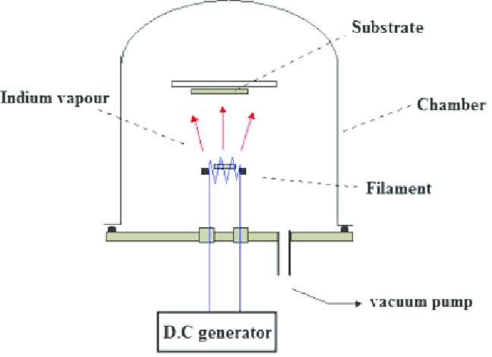
Resistive evaporation

Slide 24
The metal, alloys and many other new materials are synthesized by using this technique. It is very simple and convenient technique of evaporation. It requires only sufficient vacuum environment. Sufficient amount of heat is given to the substance to attain the necessary vapour pressure for the evaporation in this method. The evaporated materials/compounds deposited on a substrate kept at a suitable temperature. The oldest process is evaporation from a boat or a wire, which consists of a refractory metal (W, Ta, or Mo), heated by an electric current. Vapor sources of different designs are used for evaporation depending on the evaporant material.

Slide 25
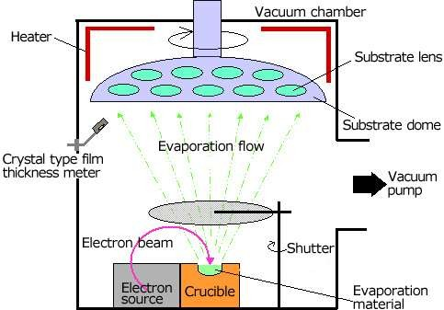
Electron beam evaporation

Slide 26
In this technique a beam of electron is accelerated through a field of 5 KeV to 10 keV and is focused onto the surface of the material for evaporation. The electrons bombard rapidly on the surface and material melts at the surface and evaporates. This allows synthesis of high purity thin films because crucible materials or their reaction products are practically excluded from evaporation. The electrons emitted from a tungsten cathode are accelerated by high voltages are focused on the substance to be evaporated, which is put in a water-cooled crucible. The kinetic energy of the electrons is transformed into thermal energy, so that the material in the crucible melts and evaporates into the vacuum.

Slide 27
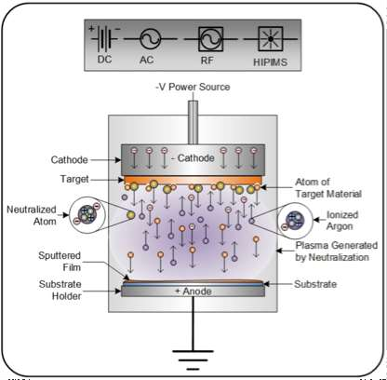
Radio frequency heating

Slide 28
Radio frequency can be used to heat the evaporant by a suitable arrangement of RF coils, levitation and evaporation can be achieved, thereby eliminating the possibility of contamination of the film by the support crucible. The radio frequency heating, includes the heating materials by the application of radiowaves having high frequency (above 70,000 hertz, (cycles per second)). This method is again divided into two sub methods. One of these, induction heating is highly effective for heating metals and other materials that are relatively good electrical conductors. The other method, called dielectric heating, is used with materials that are poor conductors of electricity.

Slide 29
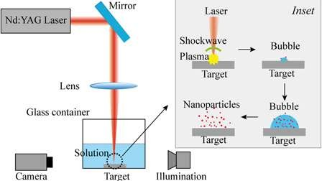
Laser evaporation
For the ejection of particles into vacuum the high power, pulsed laser beams can be used. The laser source, kept outside the vacuum system, is focused onto the target material, and the ejected material is deposited on the substrate, placed in front of the target material in the vacuum system. An advantage of laser evaporation is that its high energy, alloys can be deposited without a change of composition as in flash evaporation techniques.

Slide 30
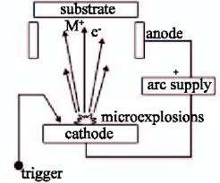
Arc evaporation
The arc evaporation method is used to apply aluminum, titanium, zirconium and chromium based hard material coatings for tools. The starting material for this vacuum based coating process takes the form of an arc cathode. In this process, an arc with a diameter of just a few microns is run over the solid, metallic coating material, causing it to evaporate. Because of the high currents and power densities used, the evaporated material is almost totally ionized and forms a high energy plasma. Theoretically the arc is a self sustaining discharge capable of sustaining large currents through electron emission from the cathode surface and the rebombardment of the surface of positive ions under high vacuum conditions.

Slide 31
Flash evaporation
Flash evaporation is one of the important technique for the synthesis of thin films alloys whose constituents have different vapor pressures. This technique requires only one boat maintained at sufficiently high temperature to evaporate the less volatile component of the alloy. This technique does not require maintaining the critical vapor pressures of the components and temperature of the boat unlike multisource thermal evaporation, which is a main advantage of this technique. In flash evaporation, the selected alloy is prepared in powder form with grain size as small as possible and is dropped onto a boat that is hot enough to make sure that the material is evaporated instantly.

Slide 32
Ion plating
The main characteristic of the ion plating technique is to use the bombardment of ions to interfere in the plating process. By making use of the activity of plasma and the bombardment effect, the energy exchange between ions, their substrate interfaces. The growing thin film compounds can be brought into existence under a temperature much lower than that conditioned by traditional thermodynamics. While, the properties such as, density of the films, adhesion between film/substrates and structure of the films are improved. Ion plating technique combined the technique of glow discharge or arc discharge of a gas, plasma technique and vacuum evaporation plating technique. In this process source is a thermal evaporation in ordinary evaporation techniques, and a glow discharge is maintained at a pressure of 10-1 torr to 10-2 torr. Particularly, the source crucible or filament acts as the anode and the substrate as the cathode.

Slide 33
B) Sputtering
The sputtering is the most versatile technique tremendously used for the synthesis of thin films. Using this technique desired composition in films with good adherence will be maintained. Whereas, it permits the better control of film thickness. The sputtering process involves the formation of gas plasma usually an inert gas such as argon by applying voltage between cathode and anode electrodes. Generally, in sputtering the ejection of surface atoms from an electrode surface by momentum transfer from bombarding ions to surface atoms. From this definition, sputtering is clearly an etching process, and used for surface cleaning and pattern delineation. The sputtering process produces a vapour of material electrode. This technique frequently used as method of thin film deposition like evaporation method. Therefore, sputter deposition is a generic name for a variety of processes.

Slide 34
Glow discharge sputtering
The glow discharge sputtering is an very simplest arrangement of sputtering technique. In an inert gas at low pressure electric field is applied between two electrodes. The cathode is a material to be deposited and a substrate is coated on the anode as a target. When the electric field is applied glow discharge is produced and the positive gas ion impact on the target plate and cathode material atoms will be ejected. These ejected atoms eventually condense on the substrate as a thin film coating. The electrode and gas phase phenomena in various kinds of glow discharges (especially RF discharges) represent a rich source of the route used to deposit and etching of thin films. Creative exploitation of these phenomena has resulted in the development of many useful processes for film deposition as well as etching process

Slide 35
Diode sputtering
Diode sputtering uses a plate of the material to be deposited as the cathode (or RF Powered) electrode (target) in a glow discharge. Thus, material can be transported from the target to a substrate to form a thin film. Films of pure metals or alloys can be deposited when using noble gas discharges (typically Ar) with metal targets.
Reactive sputtering
Compounds can be synthesized by reactive sputtering, that is sputtering elemental or alloy targets in reactive gases. Alternatively, they can be deposited directly from compound targets.

Slide 36
Bais sputtering
In this case the substrates are biased with a negative potential with respect to an anode so that it is subjected to an ion bombardment throughout the growth. This effectively cleans the substrate surface, and films with good adhesion to the substrates are formed. During the film synthesis ion bombardment can produce one or more desirable effects, such as resputtering of loosely bonded film material, low energy ion implantation, desorption of gases, conformal coverage of the surface, or modification of a large number of film properties.

Slide 37
RF sputtering
This can be used to sputter insulator films directly and also possible to sputter at low pressures. In this case an RF potential is applied to the metal electrode placed behind the dielectric plate target. In DC systems, positive charge builds up on the cathode (target) need 1012 volts to sputter insulators. Also, avoid charges build up by alternating potential. The sputter deposition occurs when the target is negative and the substrate and chamber make a very large electrode, so not much sputtering of substrate.

Slide 38
Magnetron sputtering
Another alternative in sputtering sources that uses magnetic field transverse to the electric fields at sputtering/target surfaces, which is known as magnetron sputtering. Sputtering with a transverse magnetic field produces several important modifications of the basic processes. Target generated secondary electrons do not bombard substrates because they are trapped in cycloidal trajectories near the target, and thus do not contribute to increased substrate temperature and radiation damage. In magnetron sputtering sources produces higher deposition rates than conventional sources, beneficial for economic, large area industrial application. There are cylindrical, conical, and planar magnetron sources, all with particular advantages and disadvantages for specific applications. As with other forms of sputtering, magnetron sources can be used in a reactive sputtering mode.

Slide 39
Ion beam sputtering
Ion beams, produced and extracted from glow discharges in a differently pumped system, are important to scientific investigations of sputtering, and are proving to be useful as practical thin film deposition systems for special materials in a relatively small substrate area. There are several advantages of ion beam sputtering deposition. The target and substrate are situated in a high vacuum environment rather than in a high pressure glow discharge. Glow discharge artifacts are thereby avoided, and usually results in the formation of high purity films.

Slide 40
3.3.2 Chemical techniques
The chemical synthesis refers to the synthesis of thin film on a solid substrate from a reaction occurring in a solution (almost in aqueous medium). The chemical techniques are based on either slow release of ions or slow decomposition of a complex compound. However, lots of techniques are not involved these slow steps that sometimes called chemical deposition. The chemical methods are the most important for the growth and fabrication of the thin films owing to their versatility for synthesis of new compounds at relatively low temperature. Highly crystalline layers, with a high purity thin films can be deposited with required stoichiometry. The processes are economical and have been industrially exploited to large scale. The chemical techniques are divided into two categories,
Gas phase
Liquid phase

Slide 41
A) Gas phase
Generally, in gas phase methods of thin film formation by the pure chemical processes in the gas or vapor phases. The deposition technology has turned into one of the most important means for producing thin films and coatings of a very large diversity of materials necessary for advanced technology. Particularly in solid state electronics where the most requirements such as, refined purity and composition must be controlled. In fact, if the gas flow continues for too long (typically more than a few minutes), the film tends to break up and precipitate. Since the substrate for these films is a liquid surface and the films can be picked up and transferred to another surface or possibly even be self supporting in small areas.

Slide 42
Chemical vapour deposition
Chemical vapor deposition (CVD) is a chemical technique for the synthesis of thin film of different materials. In a typical CVD process the substrate is exposed to one or more volatile precursors, which react or decompose on the substrate surface to synthesize the desired material. Frequently, volatile byproducts are also produced, which are removed by gas flow through the reaction chamber. CVD is a synthesis process in which constituents of the vapor phase react chemically near or on a substrate surface to form a solid product. The deposition technology has become one of the most important means for creating thin films and coatings of a very large variety of the purity and composition. CVD is tremendously used in the semiconductor industry, for the semiconductor device fabrication process, includes, polycrystalline, amorphous and epitaxial silicon, SiO2, silicon germanium, tungsten, silicon nitride, silicon oxynitride and titanium nitride. Also, the CVD process is used for the production synthetic diamonds.

Slide 43
CVD offers many advantages over other deposition processes. These include,
Versatile - can deposit any element or compound.
High Purity - typically 99.99 %.
High Density - nearly 100 % of theoretical.
Material formation well below the melting point.
Coatings deposited by CVD are conformal and near net shape.
Economical in production, since many parts can be
coated at the same time.

Slide 44
Photo assisted chemical vapour deposition
PACVD technique is based on activation of the reactants in the gas or vapor phase by electromagnetic
radiation. Selective absorption of photon energy by the
reactant molecules or atoms initiates the process by forming reactive free radical species that interact to form a desired film product. Mercury vapor is usually added to the
reactant gas mixture as a photosensitizer that can be activated with the radiation from a high intensity quartz mercury resonance lamp (253.7 nm wavelength).

Slide 45
Metalorganic chemical vapour deposition
The heating of organometallic solution that evaporate and deposited on the heated substrate surface, therefore it is called as, metal organic chemical vapor deposition (MOCVD) technique. It is the chemical vapour deposition method of epitaxial growth of materials, especially compound semiconductors from the surface reaction of organic compounds or metal organics and metal hydrides containing the required chemical elements. The films grown by this method, generally requires expensive, sophisticated apparatus. MOCVD possesses the potential for large area deposition, composition control, film uniformity and high film deposition rates. MOCVD has a great deal of technological importance in the fabrication of a number of optoelectronic and high speed electronic devices.

Slide 46
Flame assisted chemical vapour deposition
Flame assisted chemical vapour deposition (FACVD) is a low cost and simple atmospheric pressure CVD technique that is compatible with both small volume and high volume continuous coating processes. Use of this method with less hazardous aqueous solution of simple metal salts can yield metal oxide thin films. Therefore, this method has a major advantage in terms of cost of precursor and environmental impact compared to CVD methods. In FACVD, the flame is used to supply the required energy to crack the precursor species into fragments which subsequently form the thin film on the substrate surface. The main advantage of this technique is that closed reaction cell is not essential, so making it ideal for fitting on open production lines. However, as an open air process, the atmospheric impurities may be contaminatedduring FACVD process, which can lead to contamination within the desired thin film material.

Slide 47
Electrochemical vapour deposition
Electrochemical vapour deposition is one of the oldest and most widely used techniques for fabrication of thin films. In deposition reaction potential is more intensive and energy efficient than thermal processes, resulting in more economic production of good quality material. Contrary to the vacuum based technologies such as physical vapor deposition and chemical vapor deposition, electrochemical vapour deposition is carried out in the liquid electrolyte containing ions, which can be incorporated in the deposit, during deposition and become an impurity of the deposited thin film. The electrolyte is a major impurity source, and it is practically impossible to remove the impurity completely.

Slide 48
B) Liquid phase
The liquid phase deposition techniques are the most important tools for the deposition of the different types of
compound thin films at an ambient temperature. The
growth of inorganic thin films from liquid phases by chemical reactions is fulfilled by chemical synthesis techniques.

Slide 49
Sol gel synthesis
Sol gel has emerged in the last 20th century as a versatile, alternative method to produce ceramic materials, organic-inorganic hybrid without going to drastic thermal treatment. The sol gel process involves the transition of a solution system from a liquid "sol" (mostly colloidal) into a solid "gel" phase. Through the sol gel process, it is possible to fabricate different materials in a wide variety of forms such as, ultrafine or spherical shaped powders, thin film, fibers, porous or dense materials and extremely porous aerogel materials. This technique covers large market and touches many industrial and technological domains from applied biomedical to physics. In additional, it is particularly well adapted to thin film fabrication as a results possibility to tune and control the desired properties. In this technique precursor

Slide 50
and other solutes can be of different nature and dissolved/suspended in the liquid. The sol gel coating process takes place as follows,
The desired colloidal particles once dispersed in a liquid to form a sol.
The deposition of sol solution on the substrate surface is carried out by⎫ using spraying, dipping or spinning.
The particles in sol are polymerized through the removal of the stabilizing⎫ components and produce a gel in a state of a
continuous network.
To form amorphous crystalline coating final heat treatment is given to⎫ pyrolyse the remaining organic and inorganic components.

Slide 51
Hydrothermal synthesis
The Hydrothermal synthesis technique has been the most popular technique and increased interest from scientists and technologists of different disciplines. The word “hydrothermal” has geological origin. A self explanatory word, “hydro” meaning water and “thermal” meaning heat. British Geologist, Sir Roderick Murchison (1792– 1871) was used this word for the first time, to describe the action of water . Hydrothermal processing can be defined as any heterogeneous reaction in the presence of aqueous solvents or mineralizers under high pressure and temperature conditions to dissolve and recrystallize (recover) materials that are relatively insoluble under ordinary conditions. Hydrothermal method is used to synthesize different chemical compounds and materials using a closed system. The physical and chemical processes flowing in aqueous solutions at temperature above 100°C and pressures above 1 atm. The reaction kinetics and properties of the resulting products totally depends

Slide 52
upon the initial pH of the solution, duration, temperature of synthesis and pressure in the system. The synthesis is carried out in sealed autoclaves which are closed in steel cylinders that can withstand at high temperatures and pressure for a long time. Advantages of the hydrothermal synthesis technique include the ability to control, purity, composition, size and shape of crystals.
The hydrothermal synthesis of materials is nothing but solution processing and it can be described as super heated aqueous solution processing. Besides, for processing nanomaterials, the hydrothermal technique offers special advantages because of the highly controlled diffusivity in a strong solvent medium in a closed system. Nanomaterials require control over their physico-chemical characteristics. As the size is reduced to the nanometer range, the materials exhibit interesting chemical and physical properties compared to their conventional coarse grained counterparts due to a size quantization effect.

Slide 53
Solvothermal synthesis
Solvothermal synthesis is a technique used for synthesis of a various materials i.e. polymers, ceramics, metals and semiconductors. The process involves the use of a solvent under high pressure (1 atm and 10,000 atm) and temperature (typically between 100 °C and 1000 °C) that facilitates the interaction of precursors during synthesis. When water is used as the solvent, the method is called “hydrothermal synthesis.” Usually below the supercritical temperature of water (374 °C) the hydrothermal synthesis is performed. It can be used to prepare many materials such as, thin films, single crystals, nanocrystals and bulk powder. In addition to this, by optimizing the concentration of the solution, growth kinetics and solvent supersaturation the morphology of the crystals is controlled. Over the last few decades, a majority (~80 %) of the literature indicated that, most of researchers attention has been focused on synthesis of nanocrystals through solvothermal synthesis technique.

Slide 54
Spray pyrolysis
Numerous materials have been prepared in the form of thin films due to their potential technical value and scientific curiosity in their properties. A number of techniques have been examined in the search for the most reliable and cheapest method for the synthesis of thin films. These include oxidation of an evaporated metal in reactive and nonreactive sputtering techniques, chemical vapour deposition, etc. and a number of methods involving growth from chemical, so-called chemical techniques. Considering their simplicity and inexpensiveness, chemical techniques have been studied extensively for the synthesis of different thin film compounds. Spray pyrolysis is the simplicity of the apparatus and good productivity of large scale it offered a most attractive way for the formation of thin films of the noble metals, metal oxides, spinel oxides, chalcogenides and superconducting compounds.

Slide 55
Spray pyrolysis is the process in which a film is synthesized by spraying a solution on a heated substrate surface, in which constituent react to form chemical compounds. The selected chemical reactants are
having desired product with temperature. The substrate
volatile compounds at deposition provides thermal energy for the
decomposition and subsequent recombination of constituent species followed by sintering and crystallization of clusters and results in the formation of thin films. The required thermal energy is different for the different materials and the various solvents used in the spray process. The properties of the deposited thin film depend on the precursor solution composition, substrate temperature, spraying rate, carrier gas, ambient atmosphere, droplet size and cooling rate after deposition.

Slide 56
Electrodeposition
When the chemical changes occur due to the passage of electric current through an electrolyte is called electrolysis. Electroplating is frequently called as "electrodeposition". Deposition of any substance on an electrode as a consequence of electrolysis is called electrodeposition. As a matter of fact, "electroplating" can be considered to occur in the process of electrodeposition. It’s a process using electrical current to reduce cations of a desired material from a solution and coat that material as a thin film onto a conductive substrate surface. Since its invention in 1805 by Italian chemist, Luigi Brugnatelli, electroplating has become an extensively used industrial coating technology.

Slide 57
Its applications such as,
Decoration: Coating of more expensive metal onto a base metal surface in order to improve the appearance. Applications in
jewellery, furniture fittings, hardware and tableware.
Protection: Corrosion resistant coatings such as chromium plating
of automobile parts and domestic appliances. Zinc and cadmium plating of nuts, screws and electrical components. Wear resistant coatings such as nickel or chromium plating of bearing surfaces
and shafts and journals.
Electroforming: Manufacture of sieves, screens, dry shaver heads, record stampers, molds, and dies.
Enhancement: coatings with improved electrical and thermal conductivity, solderability, reflectivity etc.

Slide 58
The electrode gains a certain charge on itself, which attracts oppositely charged ions and molecules holding them at the electrode electrolyte interface. During electrodeposition, ion reaches the electrode surface, stabilizes on it, releases their charges and undergoes electrochemical reaction. The rapid layer depletion of the depositing ions from the double layer is compensated by a continuous supply of fresh ions from the bulk electrolyte. The factors affecting the electrodeposition process are current, pH of an electrolyte, bath composition, agitation, temperature of bath solution and the shape of electrode. The electrodeposition process is well suited to make films of metals such as copper, gold and nickel. The films can be made in any thickness from ~1 µm to > 100 µm. The deposition is best controlled when used with an external electrical potential, however, it requires electrical contact to the substrate when immersed in the liquid bath.

Slide 59
Microwave synthesis
Microwave assisted synthesis is emerging as a new lead synthesis technique in synthetic materials chemistry. The technique offers the synthesis of different compounds in simple, clean, fast, efficient, and economic route. In the recent year microwave assisted organic reaction has emerged as a new tool in organic synthesis. An important advantage of this technology includes high acceleration rate of the reaction, decrease in reaction time with an improvement in the yield and quality of the product. This technology has the potential to have a large impact on the fields of screening, combinatorial chemistry, medicinal chemistry and drug development and therefore still used under the laboratory scale. In general, synthesis methods have tedious apparatus set up, longer heating time and excessive use of solvents/reagents which result in an increase in the overall cost of the process. In the microwave heating, use of electromagnetic waves ranges from 0.01 m to 1 m wavelength of certain frequency to generate heat in the material. These microwaves lie in the region of the electromagnetic spectrum between IR and radio wave. They are defined as those waves with wavelengths between 0.01 m to 1 m, corresponding to the frequency of 30 GHz to 0.3 GHz.

Slide 60
The basic principle behind the heating in microwave oven is due to the interaction of charge atoms of the reaction material with an electromagnetic wavelength of particular frequencies. It is generally accepted that, in a liquid bath, constant reorientation created by the interaction of the dipole moment of the molecules in high frequency electromagnetic radiation leads to a friction and collisions between molecules, which subsequently generates heat [39, 40]. When applying microwave irradiation in a chemical bath, the reaction time can be reduced quickly. Meanwhile, the adherence between films and substrates can be increased tremendously than that subject to conventional heating.

Slide 61
Successive ionic layer adsorption and reaction
Thin films are obtained using SILAR technique by successive immersion of substrate into separately placed cationic and anionic precursors solution followed by rinsing between every immersion with ion-exchanged water/alcohol. This results in precipitation formation and wastage of the solution are avoided. The SILAR is based on sequential reaction on the substrate surface and rinsing follows each reaction, which enables heterogeneous reaction between the solid phase and the solvated ions in the solution. The SILAR process is intended to grow thin films of water insoluble ionic or ion covalent compounds by heterogeneous chemical reaction at the solid solution interface between adsorbed cations and anion. The SILAR results in pinhole free and uniform deposits, since the basic building blocks are ions instead of atoms.

Slide 62
Chemical bath deposition
Lots of techniques are available in the recent times and used by researchers in the deposition of thin films of different materials on various substrates. Chemical bath deposition (CBD) has of great commercial value than other techniques and has attracted the attention of researchers today due to its simplicity, convenience, reproducibility, large area deposition and commercial production. The solution growth technique was pioneered by the works of Bode and co-workers at Santa Barbara Research Centre, Kitaev and co-workers at Ural Polytechnic (Kitaev & Terekhova, 1970). The technique itself was first used in 1946 to synthesize PbS thin films for infrared applications. The main feature of CBD is that it requires a simple solution bath and substrate mounting devices. The wastage of bath solution after each deposition is the one of the disadvantages of this method. Through the relatively simple process, CBD yields well adherent and homogeneous thin films with good reproducibility. The growth of thin film strongly depends on various growth conditions, such as the temperature of the solution, duration of deposition, composition and the

Slide 63
chemical nature of the substrate. The CBD is widely used for synthesis of chalcogenide, oxide thin films onto different substrates such as glass, steel and conducting glass etc.
In chemical techniques two types of nucleation take place in bath solution: homogeneous and heterogeneous nucleation. The rapid formation of larger particles throughout the solution, as precipitate is nothing but homogeneous nucleation process. While, heterogeneous nucleation occurs at the substrate surface and particles grow slowly to form a thin film. The CBD involves two steps, nucleation and particle growth, and is based on the formation of solid phase from a solution. The chemical synthesis can synthesize any compound that satisfies following basic necessities,
The compound can be produced by simple precipitation.
The compound should be chemically stable in the solution.
If the reaction proceeds via the free anion, then this anion should be⎫ relatively slowly generated.

Slide 64
Arrested precipitation technique
The APT is also called as controlled precipitation technique and it is a modified CBD technique, based on controlled release of metal ions and involves kinetically controlled nucleation of metal chalcogenides [44]. It is characterized by simple formulation of set up, low temperature processing and has potential to replace expensive, sophisticated technique. Also the properties of desired compound can be tuned by optimizing the pH of the bath solution, precursor concentration, deposition time, temperature. The controlled dissociation/release of metal ions facilitated through arrested metal ions by a stable complexing agent such as, triethanolamine (TEA), ethylenediaminetetraacetic acid (EDTA), tartaric acid (TA), citric acid, etc. The thin film formation involves creation of a nucleation center at the substrate surface followed by growth of metal chalcogenide by ion by ion condensation followed by multinucleation of appropriate ions from bound stable complexes.

Slide 65
The APT is based on Ostwald ripening process. Initially, a small nucleus or embryo comes closer to each other and form a larger crystal, the ions formed by partial dissolution of the smaller, less stable crystal can be incorporated into the larger stable crystal. As the smaller crystal becomes even smaller, its dissolution will become more favorable and eventually it will disappear. The further result is that the larger crystals grow at the expense of the smaller ones. If the concentration of particles is sufficiently increased/high, then the probability of collisions between these particles becomes more. Result in either aggregation or coalescence. When two particles approach each other, the Van der Waals force of attraction between them will often cause them to stick together. This can continue until a large particle comprising the individual particles has formed. This is the process of aggregation, and the resulting large particle is called an aggregate.

Slide 66
The important characteristic features of APT are as follows,
It is simple, cost effective, self organized growth process and does not require sophisticated instrumentation.
The synthesis is carried out at low temperature and avoids oxidation or corrosion of the metallic substrates.
Slow film formation process is favorable for improvement in surface. morphology with enhanced grain structures over the substrate surface.
It is best suited for large area depositions of thin film.
For synthesis of doped and mixed films, mixant/dopant solution added directly into the reaction bath.
The electrical conductivity of the substrate material is not an important
criterion.
An intimate contact between reacting species and the substrate material permit uniform and pinhole free deposition on the substrate surface.
Dissociation of organometallic complexes to release free metal ions for reaction well controlled by maintaining the pH of reaction bath.

Slide 67
3.4 Common features thin film technologies.
The origin of thin films of any materials created by various deposition techniques, which starts with a random nucleation process, followed by the nucleation and growth stages.
During thin film formation, nucleation and growth processes are mainly dependent upon various deposition parameters, such as growth temperature, growth rate and substrate chemistry, etc.
The nucleation process can be modified significantly by external activities, such as an electron or ion bombardment.
During the nucleation process, deposition parameter affects on film microstructure, associated defect structure and film stress.
The crystal phase and orientation of the thin films are governed by the deposition conditions.

